Slide 1


Capstone Project "Zero Waste Company" Applied Data Science Capstone by IBM/Coursera
Martin Dominguez, July 2020

Slide 2
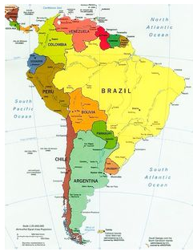
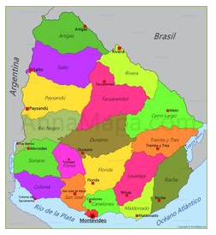
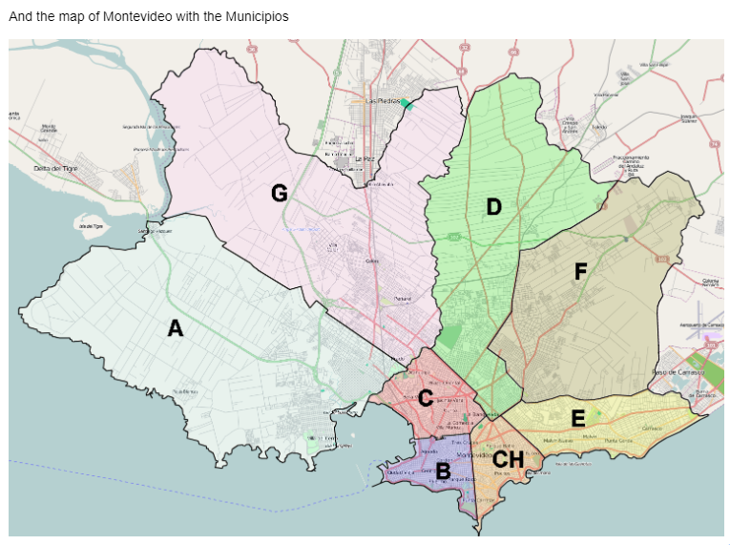
Business problem

Slide 3
ZWC PREREQUISITES – fixed parameters
The ZWC will sell medium to high price products. Therefore, it must be located in a neighborhood of medium to high economic social level and high density area.
The shop shall be located near similar shops as healthy restaurants, coffe shops, take and go, etc. This is to be closer and exposed to more customers (or potential customers).
Also, part of the positive environment impact is to be a station of re-usable and recyclable packagest, compostable garabage. This must be considerer as a part of the location selection.

Slide 4
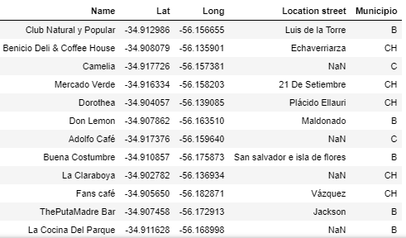
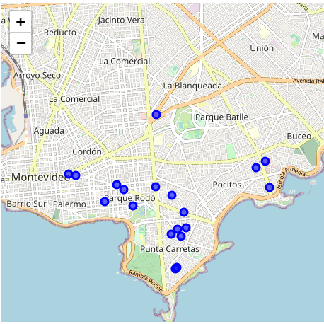
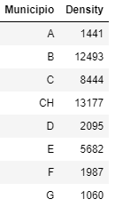
DATA
Three sources:
Foursquare
Goverment data base
Rental shops data base
Maps from folium library

Slide 5
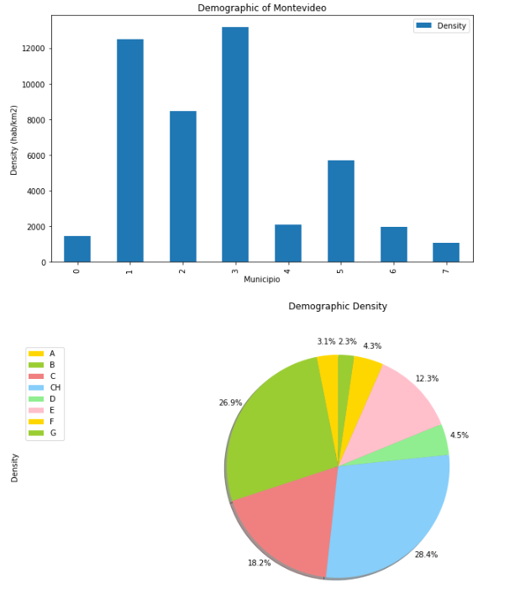
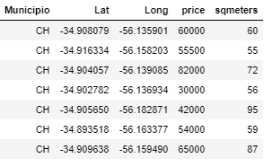
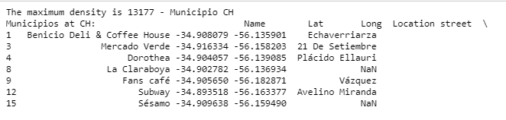
METHODOLOGY
DEMOGRAPHY BY MUNICIPIO
RELATED SHOPs distribution
Rental shops available and optimal

Slide 6
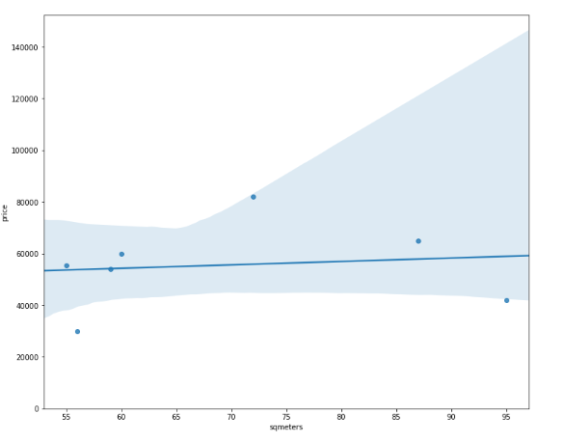
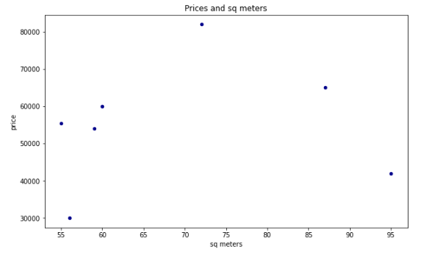

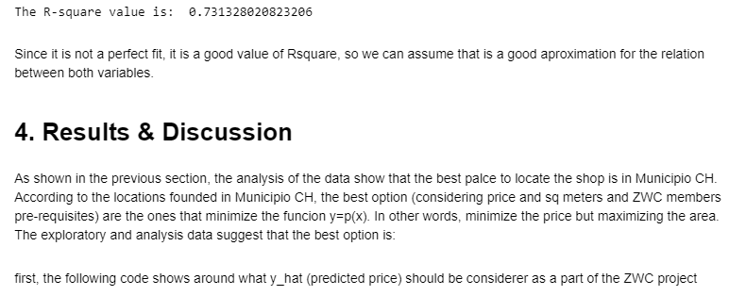
RESULTS AND DISCUSSION
Relation between variables:
Linear
Polynomial

Slide 7
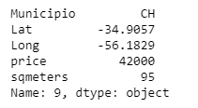
CONCLUSION
It was found the relation between dempgraphy density and shops related with heathy products.
Also, a relation was found for price and sq meters for available rental shops.
Now, the ZWC have the best option to locate its shop and also a methodology to follow in case they need/want to move or expand operations along the city, country or the same method could be applied for other locations.
This study is also applicable for other applications related with the location of a shop, even the topic that it is about.

